Slide 1
Arume

Slide 2
What is Arume?
A software framework to (hopefully) make life easier to anybody in the lab programming a new experiment. Based on Matlab and Psychtoolbox.
Takes care of some of the “boring” things when running experiment
Save and organize data
Start/stop/resume
Error handling
Randomization
Etc.
So the experimenter only has to define the conditions or trial table for the experiment and the code for running a trial

Slide 3
What is Arume?
Not just for running experiments. Also to analyze them.
Include some of the common and standard eye movement analysis and plots
Saccade detection
Nystagmus analysis
Etc…
Gives a framework to add new analysis and plots

Slide 4
What Arume is not
A wrapper around Psychtoolbox.
Still have to use the “Screen(….)” primitives to draw stimulus
(although should use the Arume wrapper for Flip)
A sophisticated Psychophysics engine
No staircases, quest, or anything like that implemented.
You have to do that yourself (for now)

Slide 5
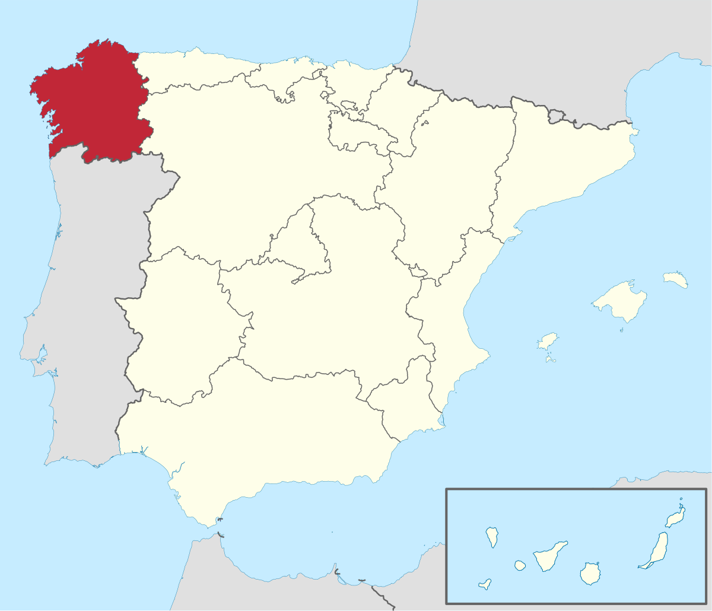
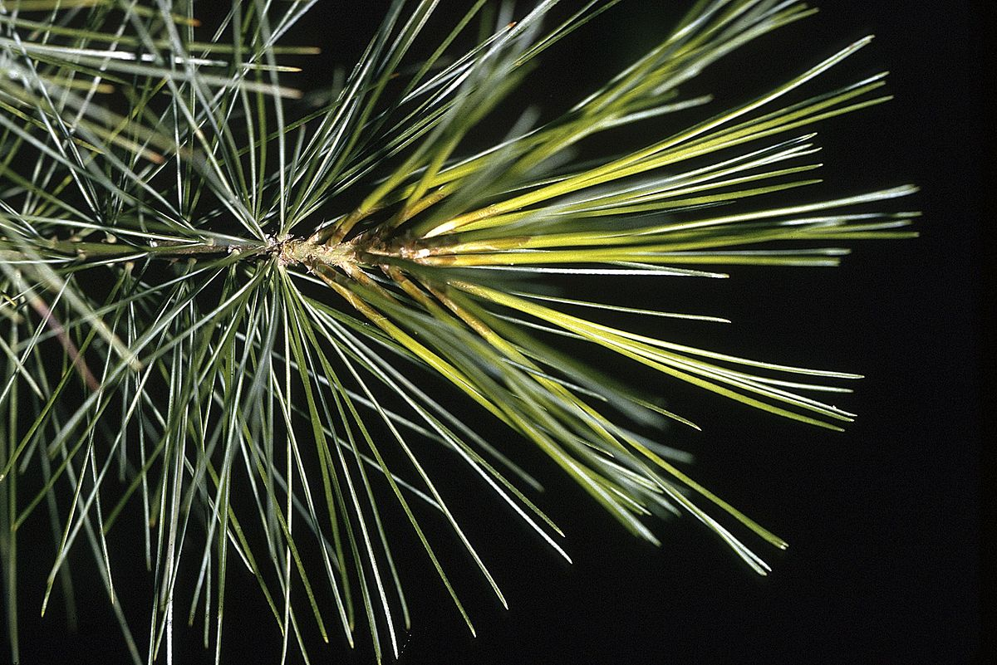
Why Arume? … because I like the word. And I thought it would be easy to pronounce and remember.
Galician Anthem
Que din os rumorosos
na costa verdescente, ao raio transparente do prácido luar?
Que din as altas copas de escuro arume arpado co seu ben compasado monótono fungar?

Slide 6
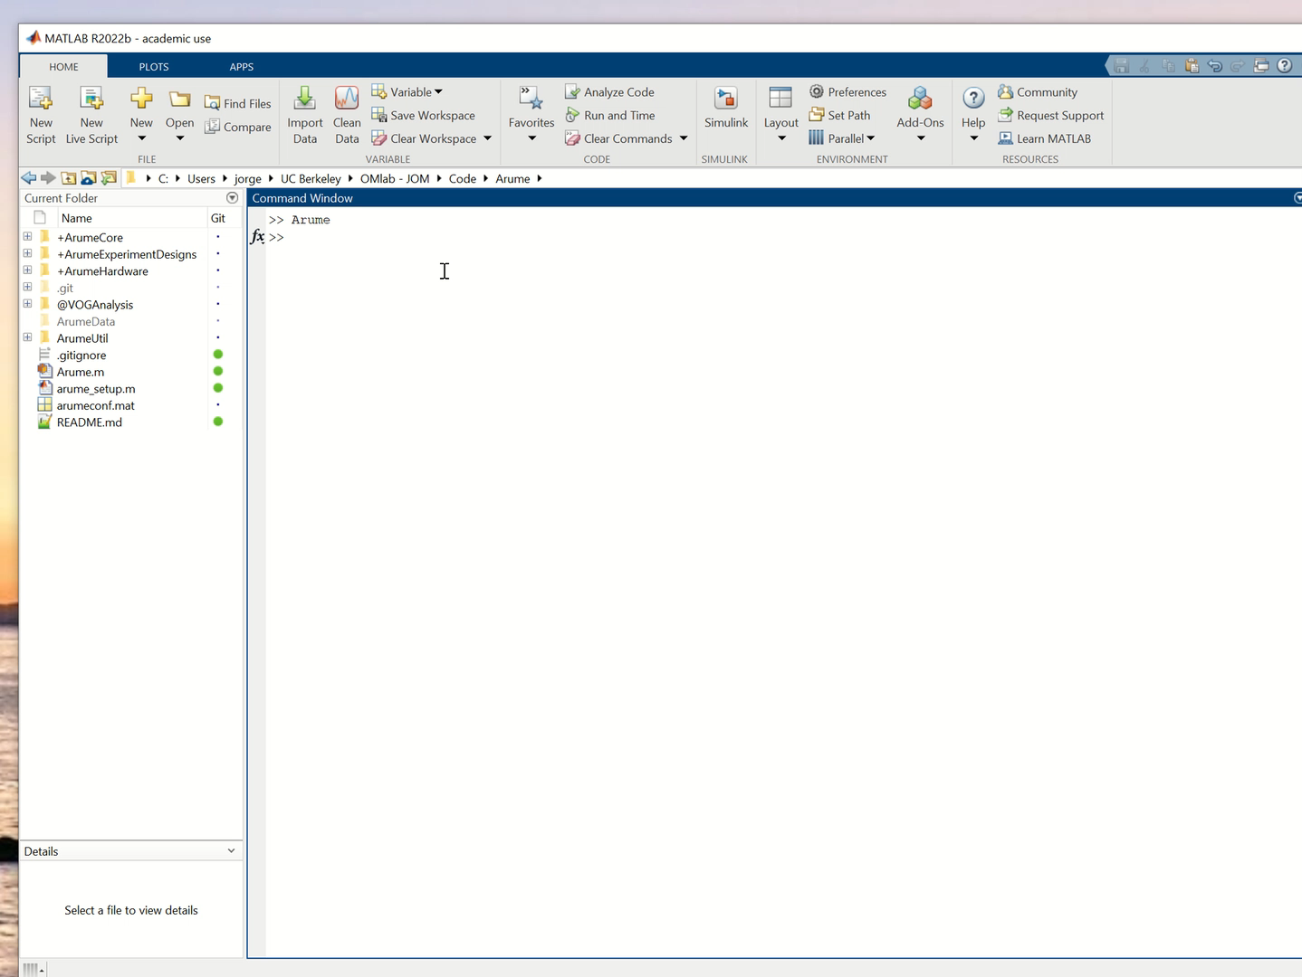
Arume – setup – start – new project

Slide 7
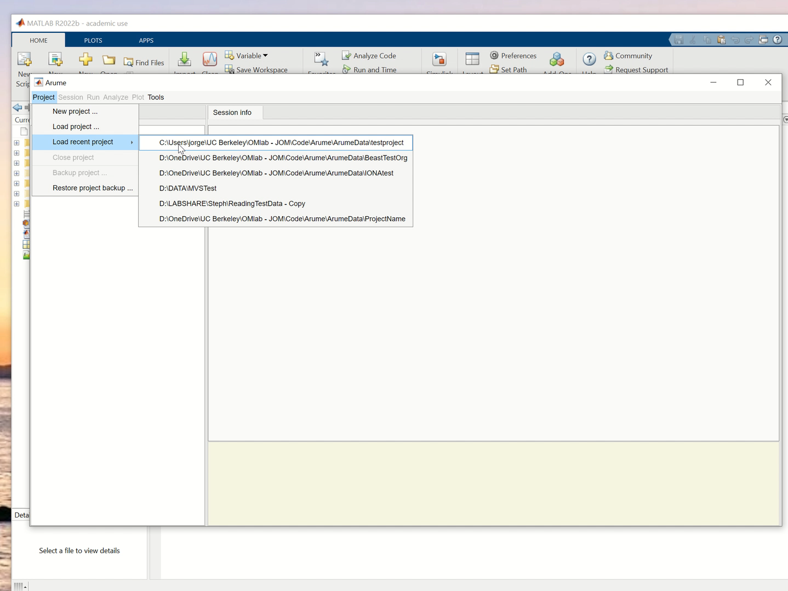
New session

